Slide 1

A Project Review Meeting on Project Title
By
Y Nishanth Reddy 2420030667
M Varshitha 2420080003
Sai Charan 2420080088
Team Number: 20
Under the guidance of
Dr. P. Srilatha
Associate Professor
Department of Computer Science and Engineering
Koneru Lakshmaiah Education Foundation (Deemed to be University estd. u/s. 3 of the UGC Act, 1956) Off-Campus: Bachupally-Gandimaisamma Road, Bowrampet, Hyderabad, Telangana - 500 043. Phone No: 7815926816, www.klh.edu.in

Slide 2
Outline of the Presentation
Abstract
Introduction
Problem Statement
Project Flow Diagram
Objectives with Justification
Modules[Frontend web pages]
Expected Outcomes of the Proposed Work
Conclusion
References

Slide 3
Abstract
Managing personal finances is a crucial aspect of daily life, yet many individuals, especially students and young professionals, face challenges in keeping track of their income and expenses. Traditional approaches such as manual record-keeping or spreadsheets are often time-consuming, prone to error, and inconvenient. To address this issue, our project introduces BudgetBuddy, a Personal Finance Tracker designed to simplify and streamline financial management.
BudgetBuddy provides an interactive and user-friendly interface where users can add transactions by entering the description, amount, type (income or expense), and preferred currency. The system automatically updates and displays the total income, expenses, and balance in real-time. Additionally, a transaction history is maintained, allowing users to review past records and delete entries if required. The website also includes a User Profile section, where users can input personal details such as name, email, contact number, age, and gender, making the application more personalized.
Beyond tracking finances, BudgetBuddy aims to promote financial awareness and responsibility. To achieve this, the platform provides money-saving tips, expense management suggestions, and a help/FAQ section to guide users. The project is implemented using HTML, CSS, and JavaScript, ensuring lightweight functionality without requiring databases or server-side programming.
The expected outcome of BudgetBuddy is to empower users with better financial discipline, helping them make informed spending and saving decisions. Its simplicity, responsiveness, and real-time updates make it an effective digital assistant for managing personal finances, paving the way for future enhancements such as data storage, analytics, and AI-driven suggestions.

Slide 4
Introduction
Personal finance management is an essential life skill that allows individuals to maintain control over their income and expenses, yet it is often neglected due to busy lifestyles or lack of awareness. Many students and working professionals struggle to keep track of where their money goes, which leads to overspending, poor savings, and financial stress. Traditional methods such as manual record-keeping in notebooks or creating spreadsheets may work initially but are tedious, prone to error, and not user-friendly for daily use.
To address these challenges, our project introduces BudgetBuddy, a simple and interactive personal finance tracker. BudgetBuddy is designed to provide users with an intuitive platform to monitor their income, expenses, and overall balance in real-time. With just a few inputs, users can add transactions, classify them as income or expenses, and view summaries that update instantly. In addition, the platform allows users to personalize their experience by creating a profile with basic details such as name, email, and contact information.
The project also emphasizes financial awareness by offering money-saving tips, expense management suggestions, and FAQs for guidance. BudgetBuddy is built using HTML, CSS, and JavaScript, ensuring accessibility, lightweight design, and responsiveness across devices.

Slide 5
Problem Statement
Managing personal finances is a common challenge for students and professionals. Traditional methods like notebooks or spreadsheets are time-consuming, error-prone, and inconvenient for daily use. Many individuals struggle to monitor income and expenses, often leading to overspending and poor savings. There is a need for a simple, user-friendly, and real-time digital solution that helps users track finances effectively and develop better financial discipline.

Slide 6
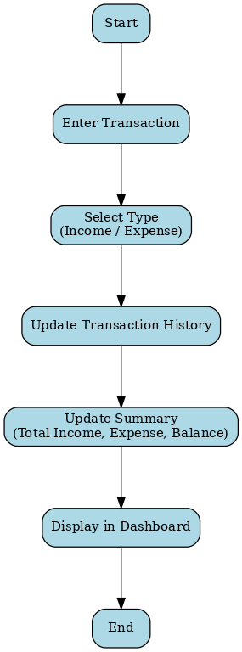
Project Flow Diagram

Slide 7
Objectives with Justification
Objective 1: Track income and expenses → Helps monitor financial health.
Objective 2: Provide real-time balance → Enables better decision making.
Objective 3: Add user profile → Personalizes the experience.
Objective 4: Offer tips and FAQs → Educates users about money management.
Objective 5: Keep design simple → Ensures accessibility for all users.

Slide 8
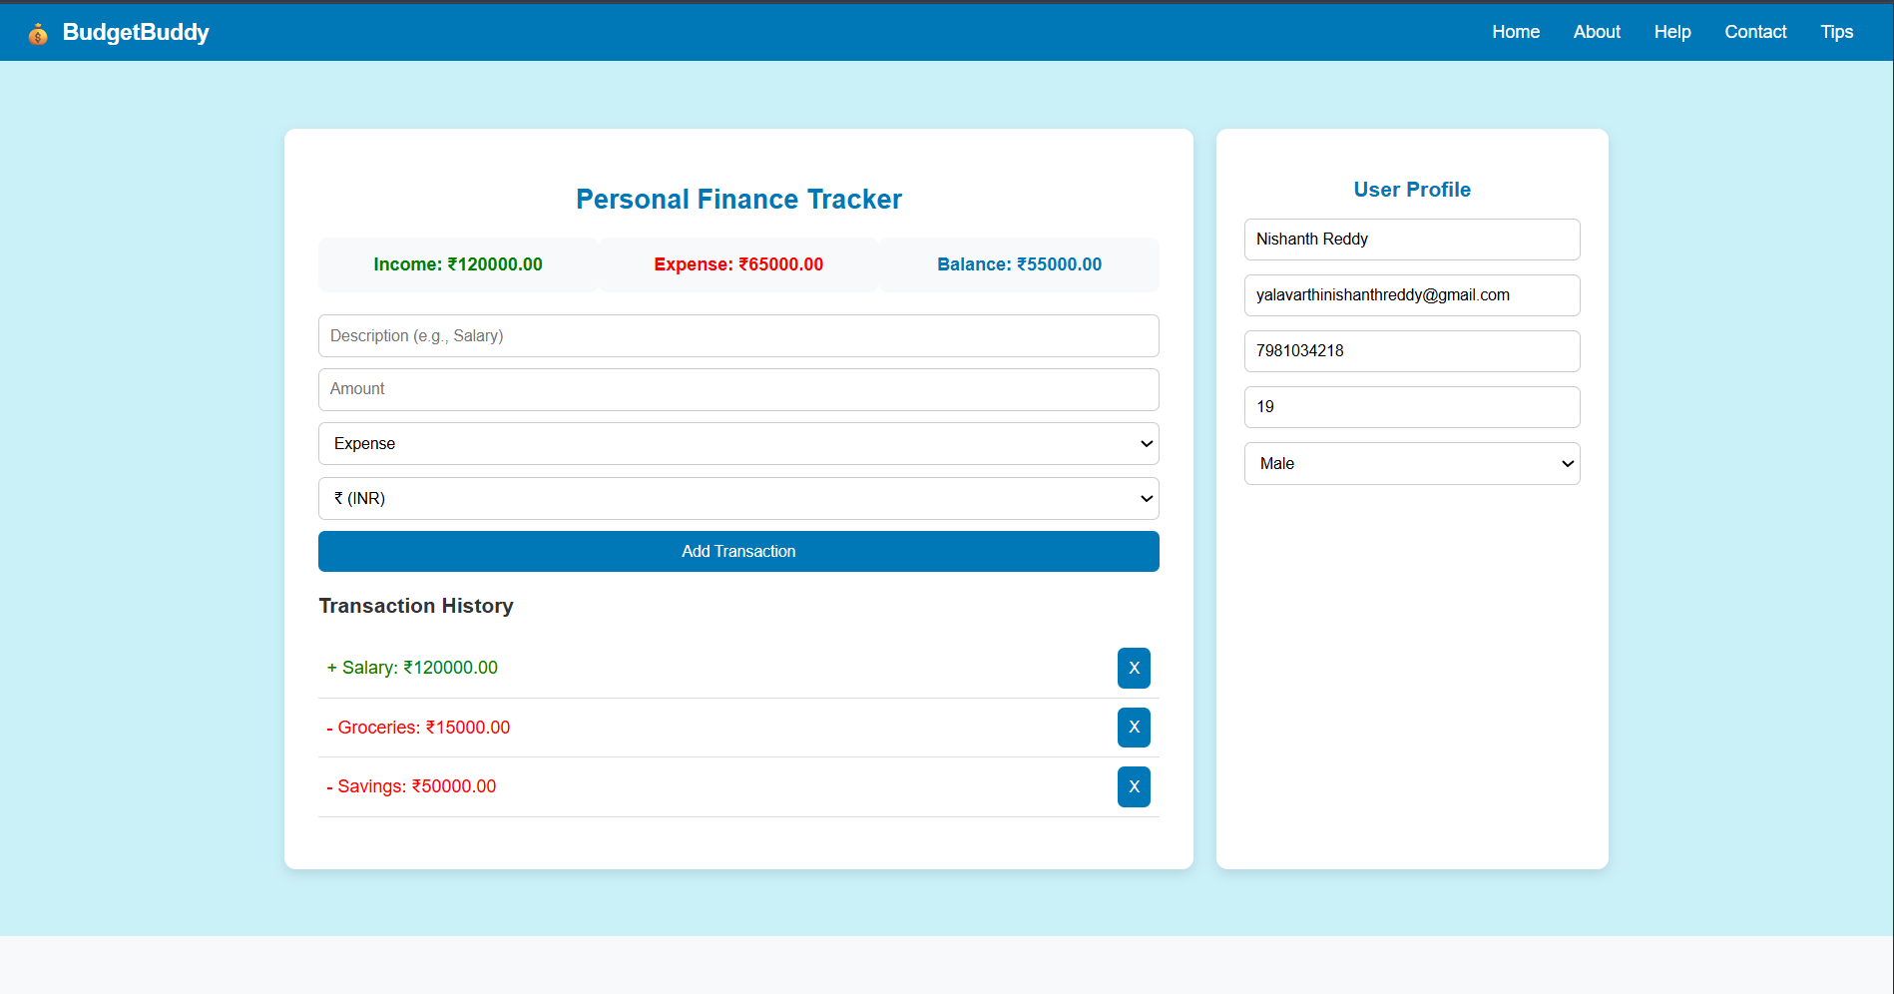
Modules [Frontend web pages]

Slide 9
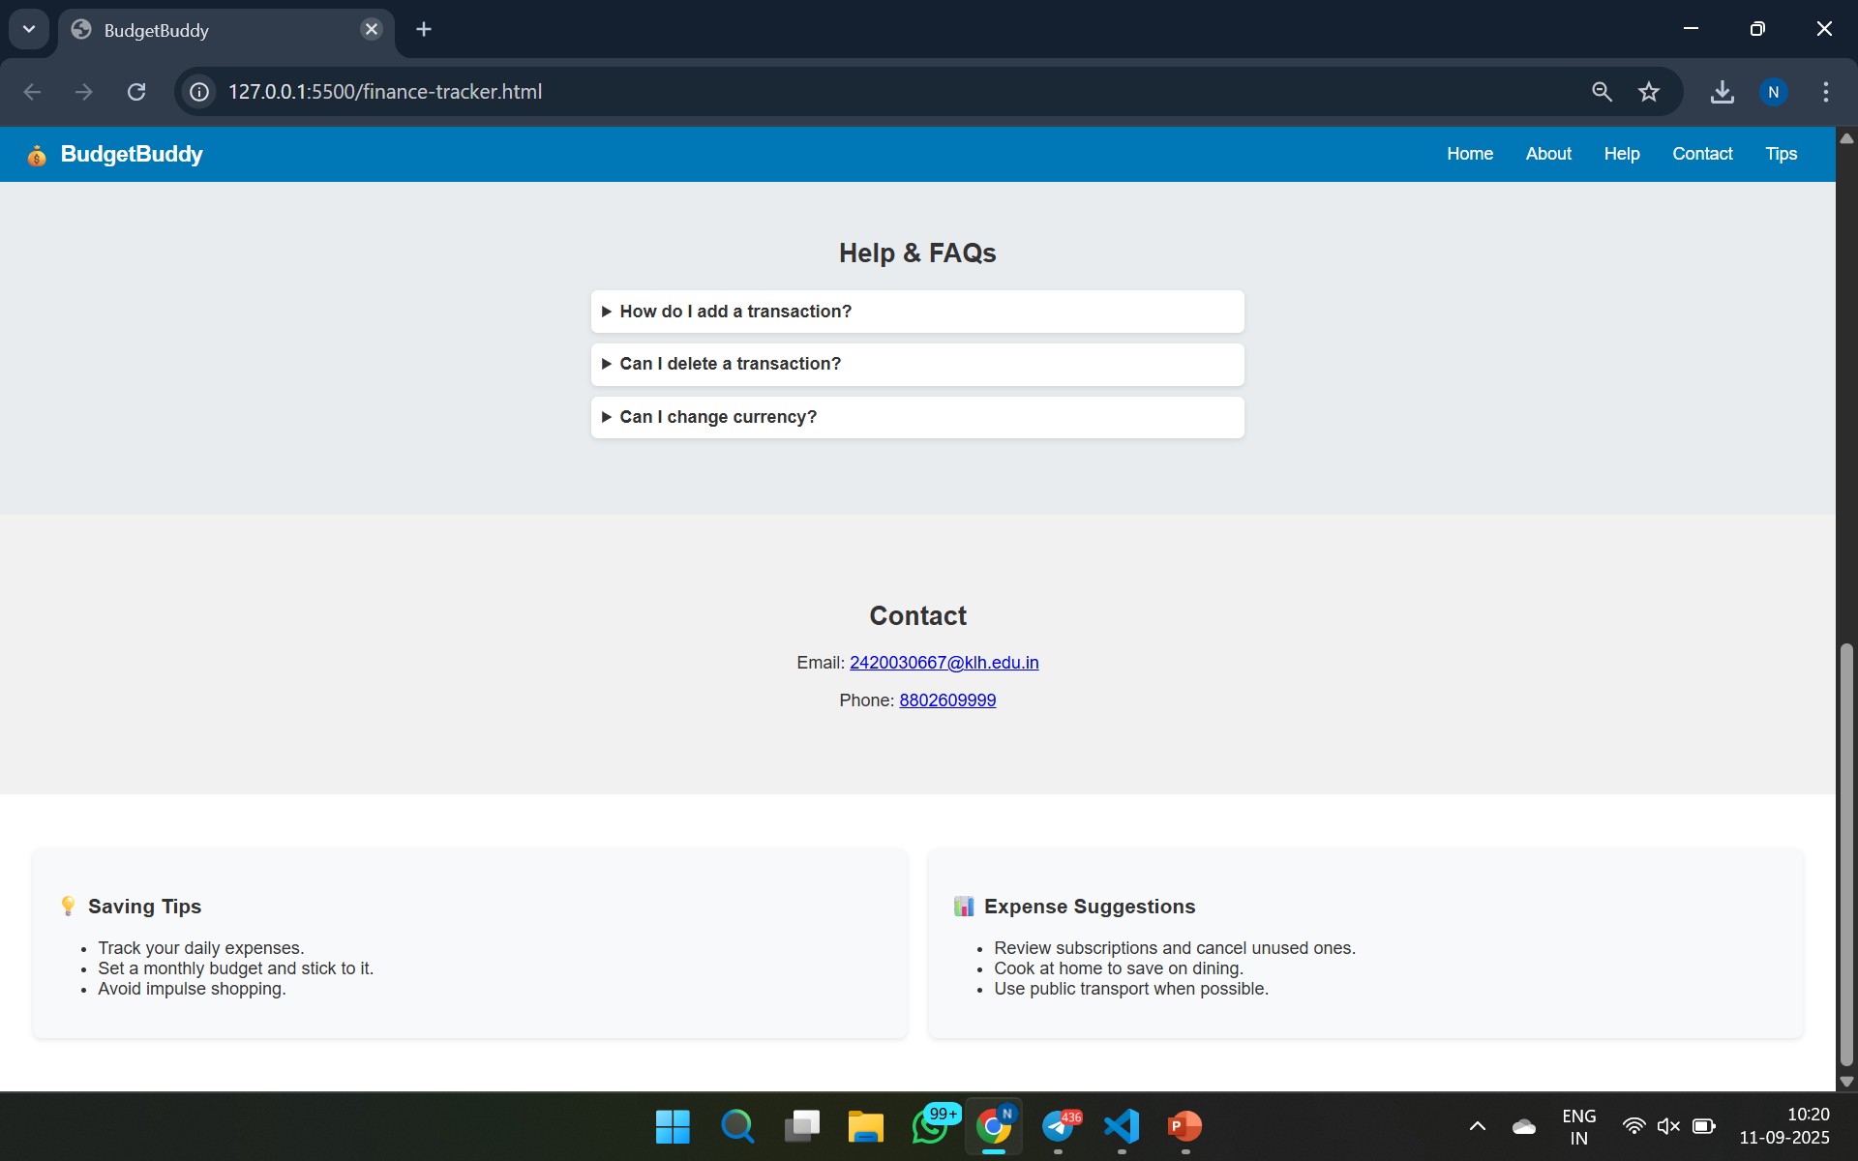

Slide 10
Expected Outcomes of the Proposed Work
Users can add, delete, and view transactions easily.
Real-time updates of income, expenses, and balance.
A personalized finance tool with user profiles.
Guidance for financial awareness through tips and FAQs.
A simple, interactive, and responsive website using only HTML, CSS, JavaScript.

Slide 11
Conclusion and Future Scope
BudgetBuddy is a simple and interactive tool for managing personal finances.
It allows users to track income, expenses, and balance in real-time.
The platform is lightweight, responsive, and easy to use.
Additional features like user profile, tips, and FAQs enhance usability.
It promotes financial awareness and better spending habits.
The project is developed using HTML, CSS, and JavaScript only.
BudgetBuddy successfully addresses the need for a user-friendly finance tracker.

Slide 12
References
www.w3schools.com (HTML, CSS, JS concepts)
developer.mozilla.org (MDN Web Docs)
GeeksforGeeks (Web development tutorials)
Project discussions & brainstorming by team

Slide 13
Thank you

